Slide 1


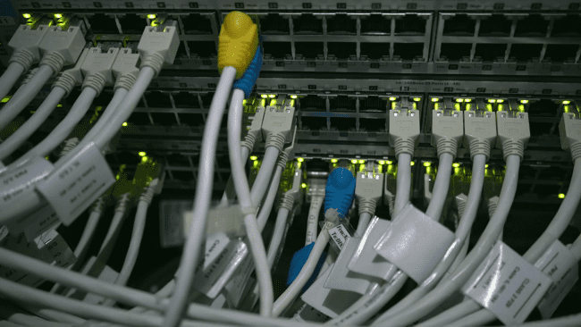

Connecting Windsor-Essex: Broadband
Group-8
Sai Abhiram GP
Brahma Teja
Yamini
Pavan Kumar
Shweta Sharma
abhiramgp/Connecting-Windsor-Essex-Broadband (github.com)

Slide 2

About Company Problem Statement Objectives Analytical Methods Dataset Stage-1: Exploratory Data Analysis Stage-2: CW-E School Data Stage-3: Weather Data Summary Conclusion References
Contents

Slide 3
Connecting Windsor-Essex began as an information technology project, focused primarily on building an extensive high-speed fiber optic network.
It is funded by the stakeholder groups including city of Windsor, The County of Essex, , UoW, St. Clair college and others.
CW-E provides fiber optic connectivity to over 200 locations in the region.
CW-E is a non profit organisation.

Slide 4

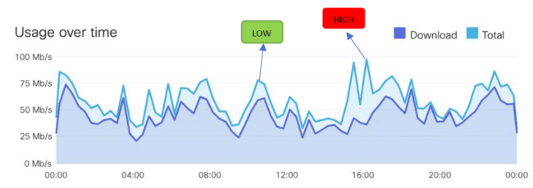
Problem statement
Evaluation of Broadband services in schools in South-Western Ontario.
It has been a concern for local independent carriers in providing connectivity to few referred locations as per CW-E. Latency, high consumption of data during day & further in the evening are the main reasons of concern.
Therefore, Carriers are managing high data usage throughout the entire day. In the past data usage looked like a sine wave i.e., high data usage in the evening and low for the day.

Slide 5




Objectives
The objective of this project is to provide analysis and recommendations concerning broadband services currently deployed by various school boards in Southwestern Ontario. These insights Include:
The Analysis of broadband quality
Analysis of broadband speed
Comparisons between carriers at the same location
Comparisons between consumption of data in different sites.
Analysis of broadband speed with respect to weather (Snow, Rain)

Slide 6

Analytical Methods
Data extraction with support of CW-E and appropriate people at the District School Board
Loading .csv files into Azure Data Lake Storage V2
Integration operations using Azure Synapse Analytics
Data Transformation using T-SQL querying
EDA using Python
Building ML Model using Azure Machine Learning Studio
Building charts and dashboards by integrating MS SQL Server with Tableau

Slide 7
Dataset
Analysing Basic Broadband Metrics (Ookla & Rogers Data)
Stage-1
Stage-2
Stage-3
CW-E School data analysis
Weather Data Analysis (Weatherstats.ca)

Slide 8
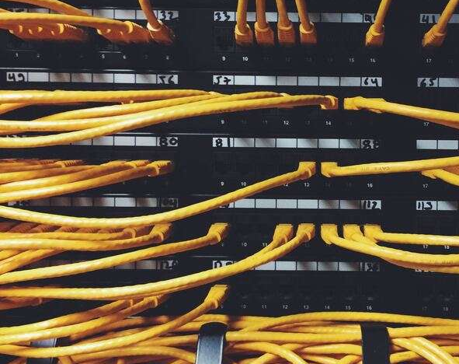
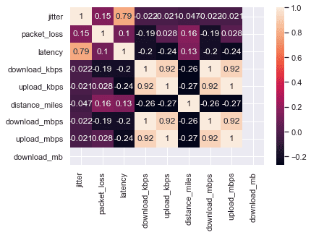
Heat Map

Slide 9
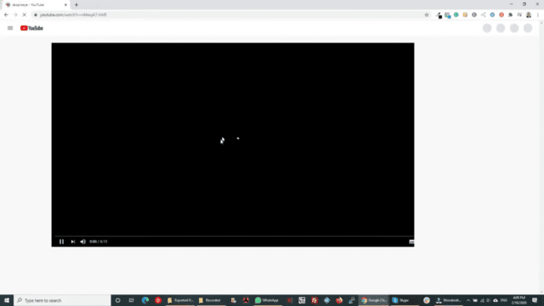

Latency
Jitter
Jitter in broadband refers to the variation in latency over time. It is a measure of the inconsistency or variability in the time it takes for data packets to travel from one point to another over a network connection.
Latency in broadband refers to the time it takes for data to travel from one point to another over a network connection. It is often measured in milliseconds (ms) and can affect the speed and responsiveness of internet applications, such as online gaming, video streaming, and video conferencing.

Slide 10


Stage-1: Analysis of broadband quality & speed
Data from:
LINK

Slide 11

Stage-2: CW-E School Data
Windsor-Essex Catholic District School Board
Lambton Kent District School Board
CKSS
ICRP
TDHS
NRPS
LCCV
GRBE
NORT
HIPK
100
113
137
164
201
208
227
232
School Codes
School Codes

Slide 12
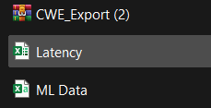
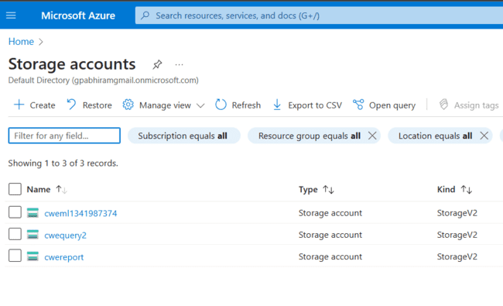

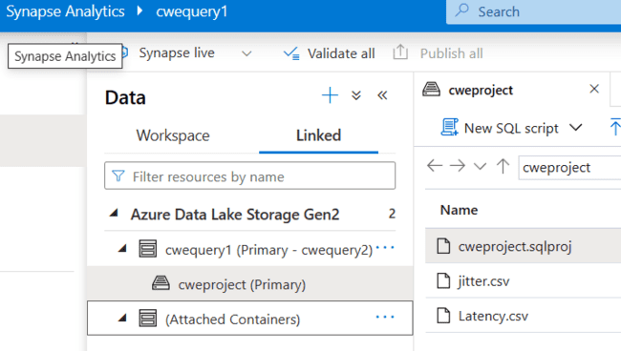
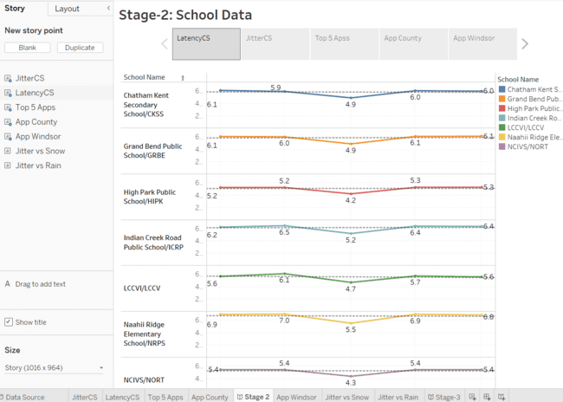
Loading data into Blob Storage
Integrating data with Synapse Analytics
Creating views with T-SQL queries
Creating visualisation using SQL Views
LINK

Slide 13

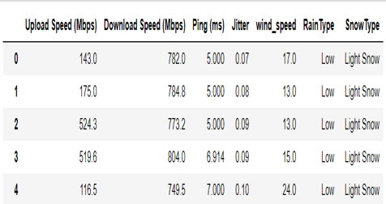

Snow Types The categories can vary depending on the purpose of the measurement, some common categories include: 1. Light snowfall:1-5 cm (0.4-2 in) of snow on the ground. 2. Moderate snowfall: 6-15 cm (2.4-6 in) of snow. 3.Heavy snowfall: 16-30 cm (6.3-11.8 in) of snow.
Stage-3: Weather Data Analysis
LINK
Data suggestion:

Slide 14
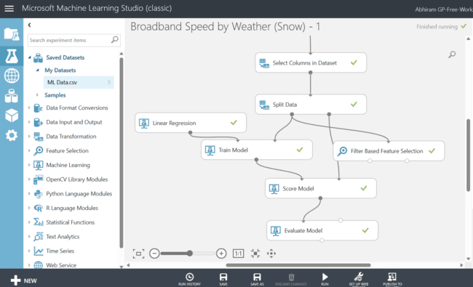
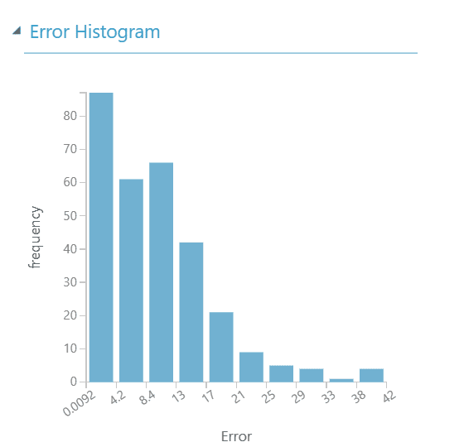
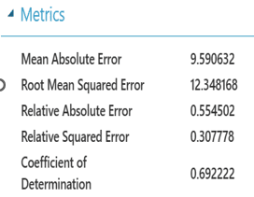
ML Model based on weather data: Snow Type

Slide 15

Summary
Rogers holds the largest distribution network with 64.2%
Windsor accounts for the highest average latency compared to Toronto.
Bell records for the highest average upload/download speed in Toronto while Rogers takes the lead in Windsor.
Max Jitter/Latency can be observed in noon between 2 – 3 PM.
Peak Jitter/Latency can be observed during months of Dec 2022 – Jan 2023 for all the listed schools.
Google services accounted for the highest consumption of data in County Schools while Other and social media applications recorded for highest consumption in Windsor Schools.
Ping/Jitter varies with extreme weather
There is minimal reduction in broadband speed with extreme snow.

Slide 16
Conclusion
Analysis of broadband quality
Analysis of broadband speed
From the visualisations it is observable that broadband quality and speed varies with respect to the variation with Latency/Jitter/Weather.
Analysis of broadband speed with respect to weather (Snow, Rain)
Minimal change in broadband speed can observed with respect to extreme weather scenario’s.
Comparisons between carriers at the same location and consumption of data in different sites
Bell records for the highest average upload/download speed in Toronto while Rogers takes the lead in Windsor.
Windsor schools accounted for highest consumption of data.

Slide 17

References
Jitter vs Latency - What’s The Difference and Why it Matters (networkmanagementsoftware.com)
Ookla’s Open Data Initiative | Ookla®
The 7 Most Useful Data Analysis Techniques [2023 Guide] (careerfoundry.com)
7 Best Practices for Successful Data Management | Tableau
Connecting Windsor-Essex (cw-e.ca)
Canada Weather Stats

Slide 18

Thank You

